Slide 1

Joseph School of Financial Discipline - JSFD

Slide 2
Some Reflections on India - 1
India is one of the fastest growing economy of this world, in spite of having a large amount of man power, land, water, air resource India continues to be a developing nation rather than a developed nation.
There is a vast difference among the people in respect to their finance.
Even though there is good promising economic growth in India the health and other Indices which states the standard of living of the people remain low.

Slide 3
Some Reflections on India - 2
Poverty, un-education, low standards of living, poor health, access to health care are problems still needed to be addressed.
Recently many children in Bihar and UP died due to encephalitis; with so much resources and money in one hand we also have poor living standards of people and high disease prevalence.
Why is this situation in India? The rich are getting richer and poor are getting poorer!

Slide 4
Some Reflections on India - 2
There is no financial discipline in India,
hence this problem.

Slide 5
1 Timothy 6:10 For the love of money is the root of all evil: which while some coveted after, they have erred from the faith, and pierced themselves through with many sorrows.

Slide 6
What have we done about this?
AOJ has introduced Joseph School of Financial Discipline to overcome this large social gap among the people of India.
This school was introduced on 19.01.2019 at Chennai, the school helps the people to discipline them self in financial matters based on the Word of God.
The below are the subjects:
Introduction to school of financial discipline
You shall not steal
Luke 16:10
Wealth and riches in Bible
Layup treasures in heaven for yourself
Money is the root of all evil
No servant can serve two masters
Make Friends for Yourself with Unrighteous mammon
Correction not an option
Where is the money in India

Slide 7
What have we done about this?
AOJ has introduced Joseph School of Financial Discipline to overcome this large social gap among the people of India.
This school was introduced on 19.01.2019 at Chennai, the school helps the people to discipline them self in financial matters based on the Word of God.
The below are the subjects:
Introduction to school of financial discipline
You shall not steal
Luke 16:10
Wealth and riches in Bible
Layup treasures in heaven for yourself
Money is the root of all evil
No servant can serve two masters
Make Friends for Yourself with Unrighteous mammon
Correction not an option
Where is the money in India

Slide 8
How did the Lord use the JSFD?
Till today JSFD classes were conducted 2 National Level classes, 4 State Level classes & 2 District Level classes in various location across the Country and more than 180 people have been trained
After attending this school many came to know the root cause of financial problem in their life, many felt the deliverance from these problems; all acknowledged the importance of taking this class to all part of India.
SN NO | City | Level | Date | Place | No of people
1 | Chennai | National | 4th & 5th May'19 | Kolathur | 30
2 | Mumbai | State | 18th & 19th Jun'19 | Vasai | 40
3 | Goa | State | 25th & 26th Jun'19 | Senta cruz | 21
4 | Delhi | State | 6th & 7th Jul'19 | Uttam Nagar | 35
5 | Chennai | District | 10th & 11th Aug'19 | DRACAH | 11
6 | Chennai | District | 14th & 15th Sep'19 | DRACAH | 12
7 | Chennai | National | 23rd & 24th Nov'19 | DRCEC | 14
8 | Gujarat | State | 28th & 29th Dec'19 | Vadodara | 19

Slide 9
SN.NO | CITY | LEVEL | DATE | PLACE | NO OF PEOPLE
9 | Chennai | National | 24,25-01-2020 | Panayoor | 8
10 | Nagercoil | District | 26,26-01-20 | Aoj Cottage | 19
11 | Udupi | District | 29-2-2020 | Basel Mission Compound | 5
12 | Mettupalayam | District | 14,15-3-2020 | Karamadai | 20
13 | Chennai Teachers Training | State | 7,8-3-2020 | Charles Elders Community | 8
14 | ZOOM Video Conferencing | National | 31-3-2020 to 4--4-2020 | All India | 40
15 | Zoom Conferencing West Zone | West Zone | 1.5.20-8.5.20 | All India | 25
16 | Zoom Conferencing | Kerala |  | Kerala
17 | Karnataka | District | 6.5.2020 | Karnataka | 6

Slide 10
Joseph School of Financial Discipline National Meet – Nov’19
By the grace of God, Joseph School of Financial Discipline National meet was held at Dr Charles Elders Community, Kathirveedu, Chennai on 23 & 24th of November 2019
Fourteen participants from different states attended the school
Safiabad, Sonipat, Haryana
Mukundapur, Kolkata, West Bengal
Baroda, Vadodara, Gujrat
Jharkhand
Bangalore, Karnataka
Odisha
Thane, Maharashtra
Goa
Rajasthan
Telangana
Today the whole country is discussing about the economy, the government is trying hard to avoid a financial recession. Everyone readily agrees that financial discipline is necessary among people, hence fourteen participants representing ten states came to attend the program and promised to conduct the school in their constituency.

Slide 11
Joseph School of Financial Discipline National Meet – Nov’19
Everyone gave testimony about the importance of this school. Steeling, working negligently, mammon sprit, horded wealth, God’s control over economy of the country, correction are the topics which enlightened them.
Plan: the participants planned to conduct the school in their representing states, the leaders from the district will come and attend the school and take the message to their respective district.

Slide 12
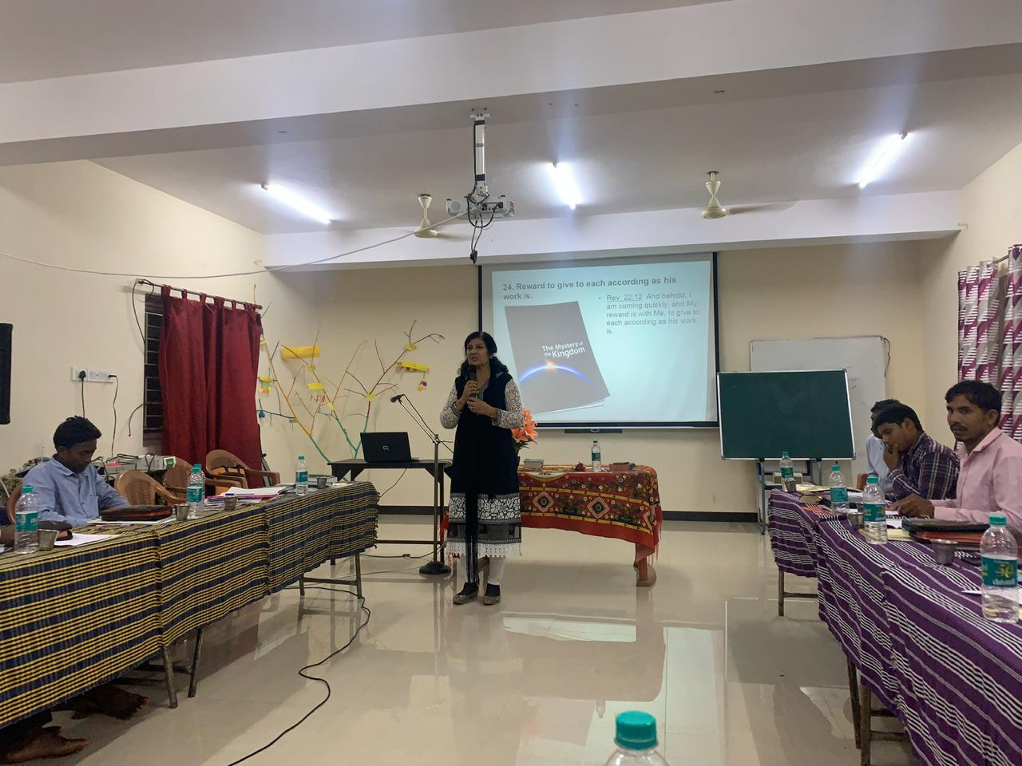
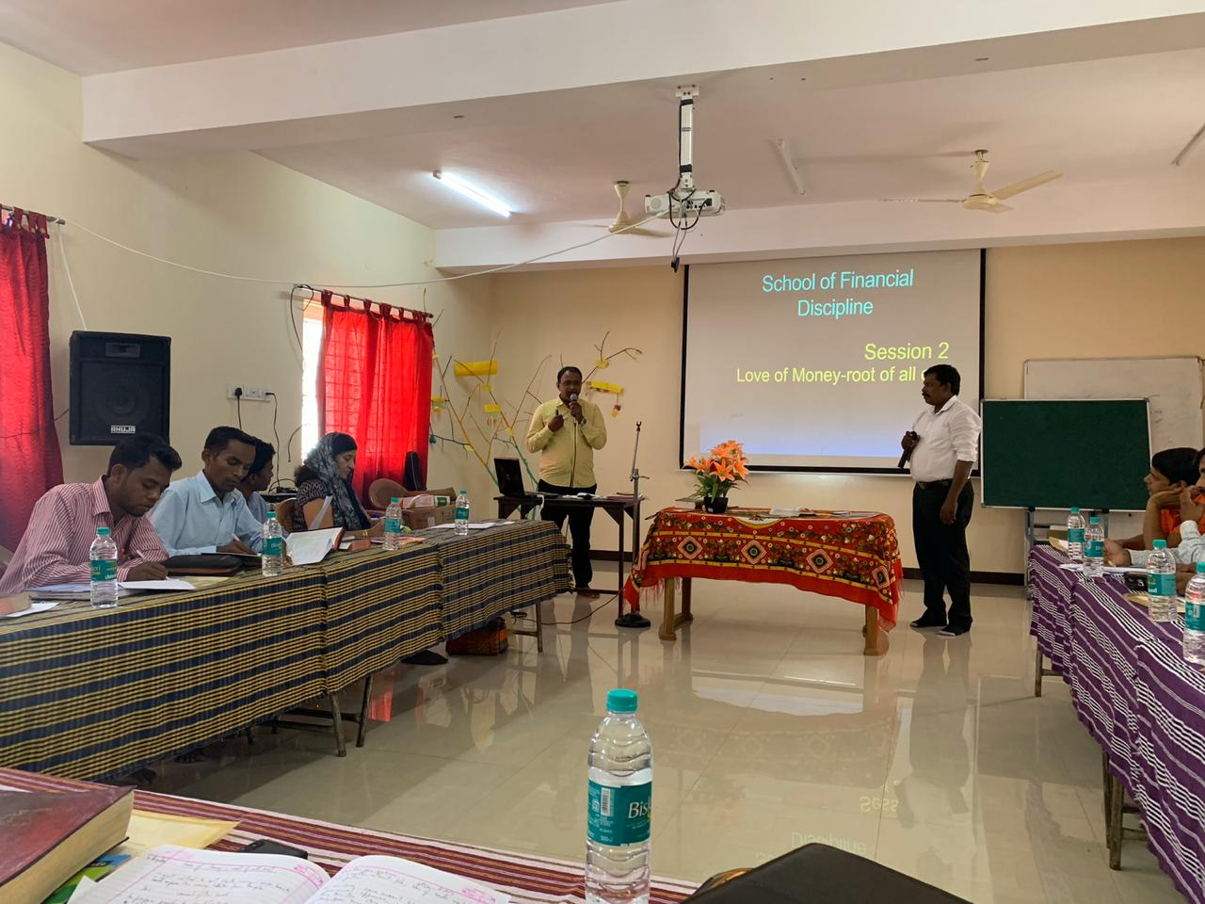
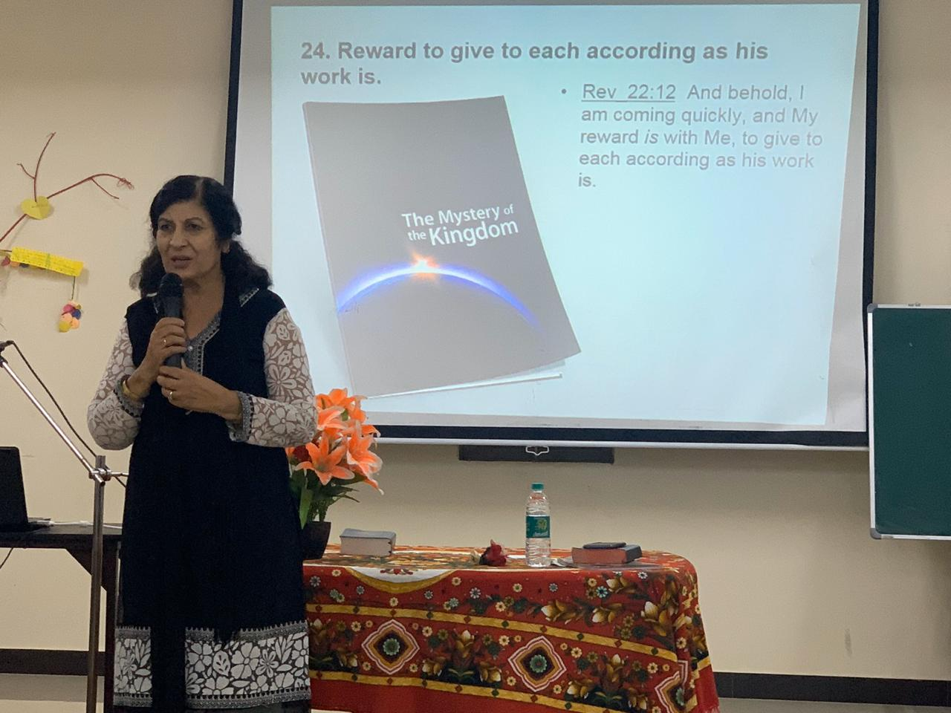
Some Memories – National Meet

Slide 13
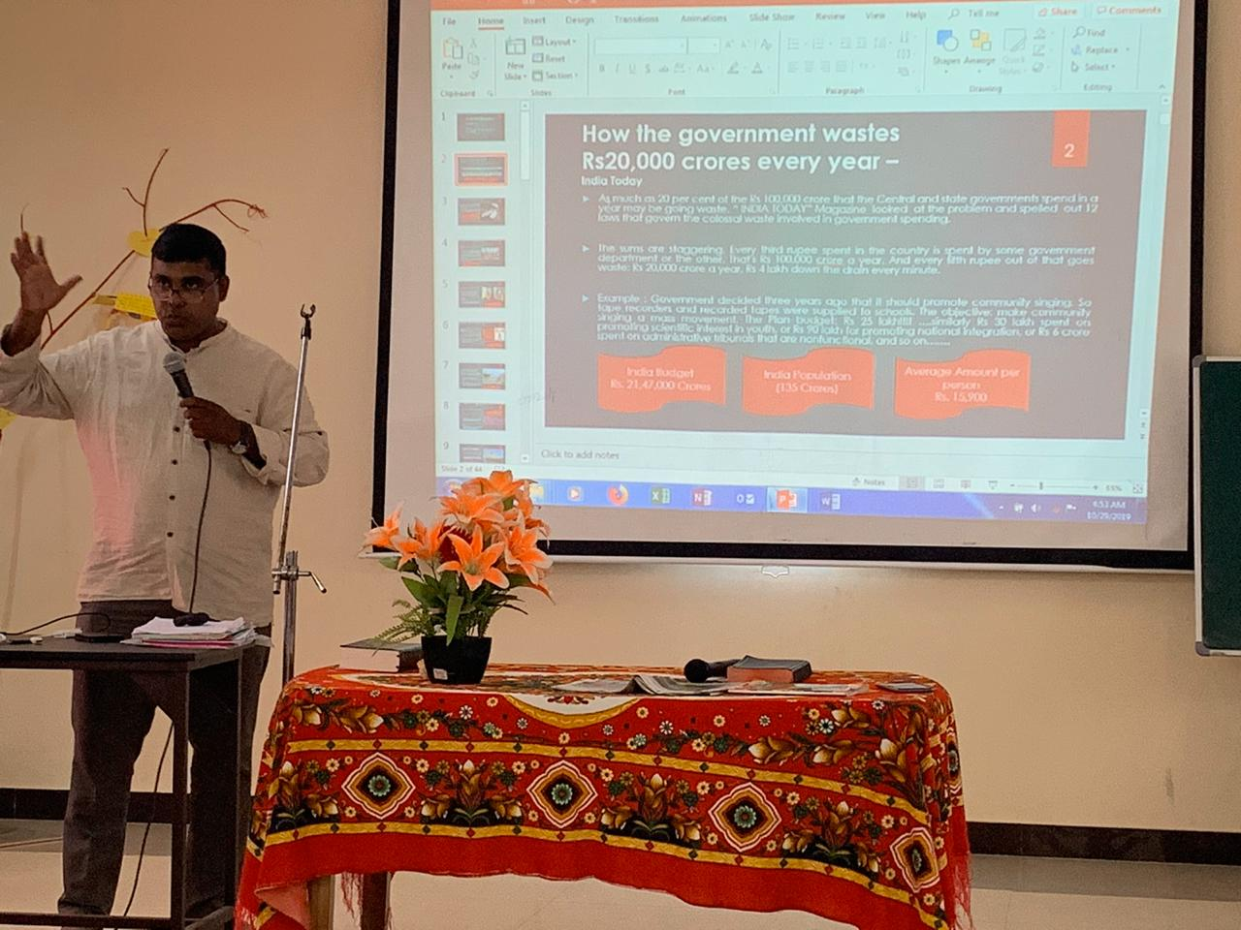
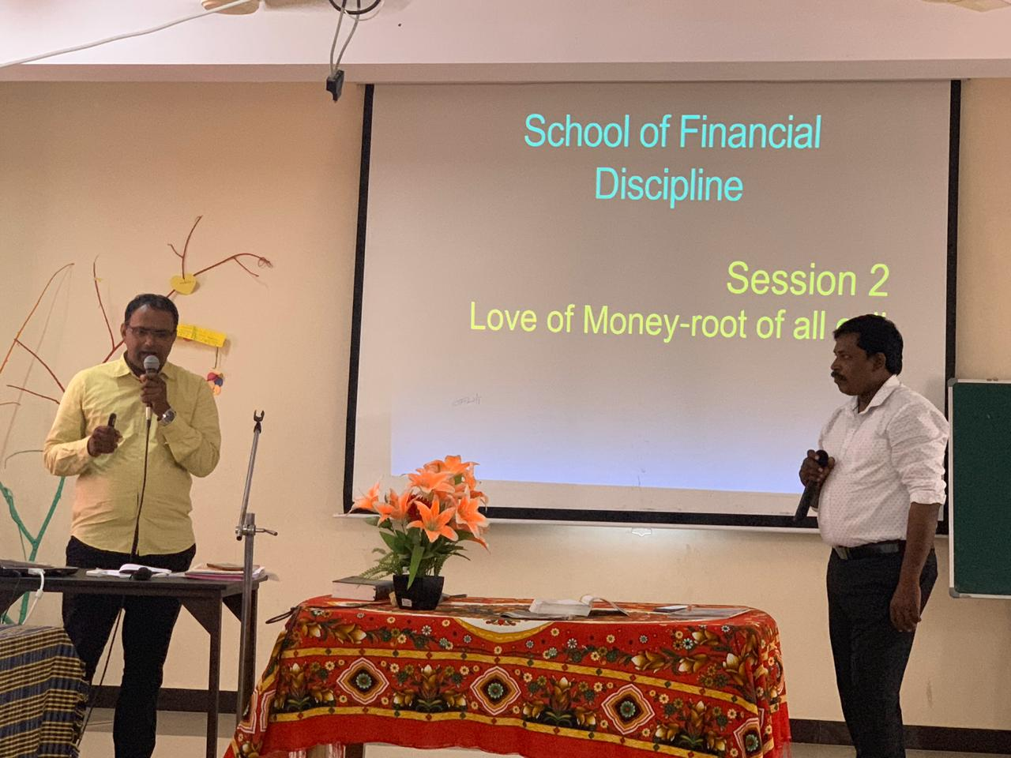
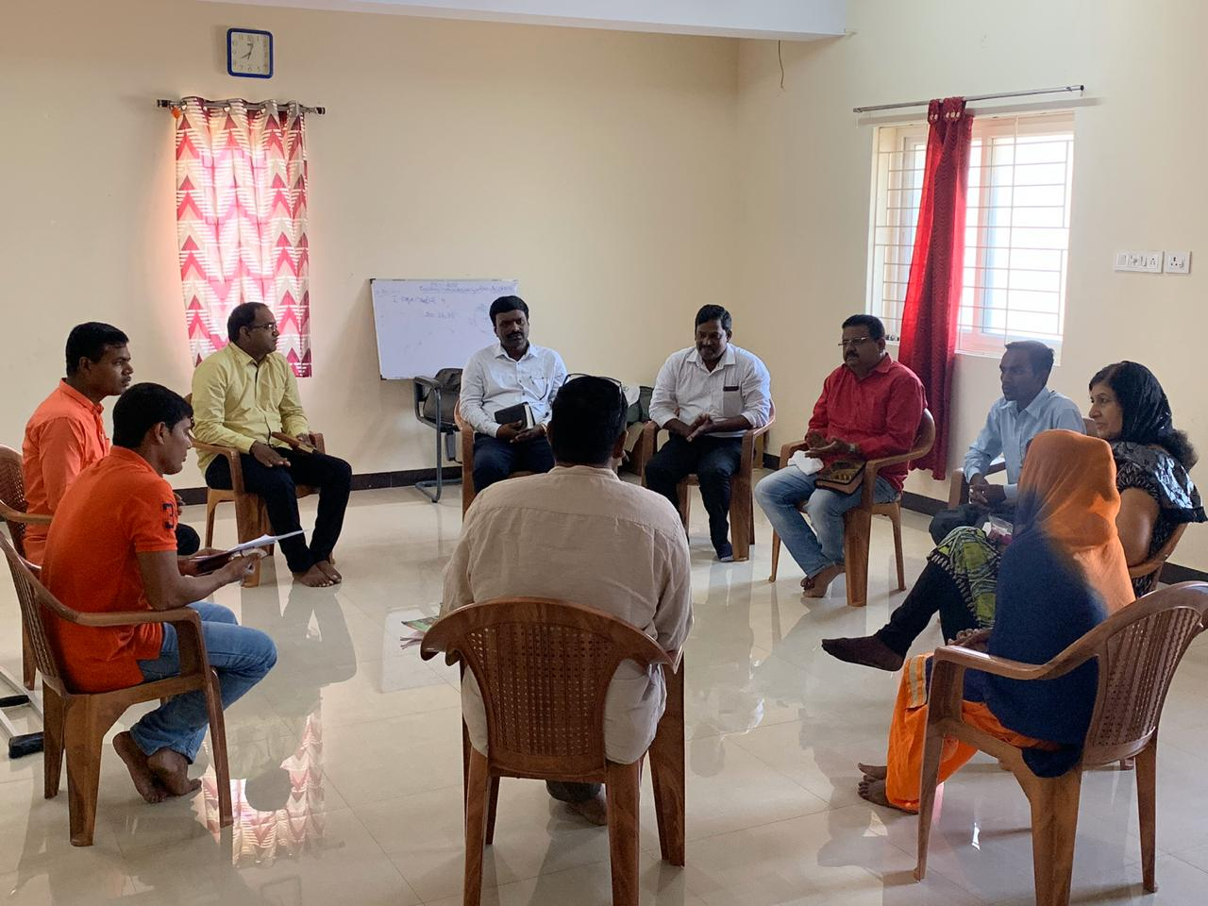
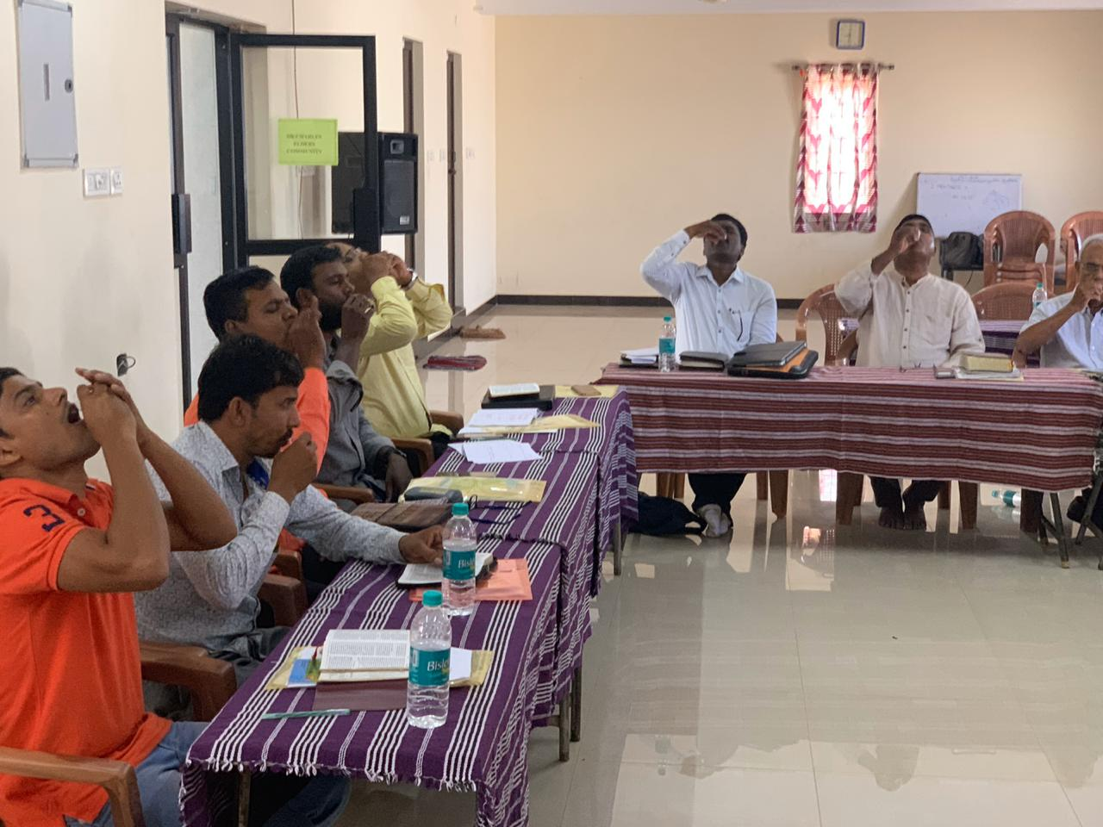
Some Memories – National Meet

Slide 14
Joseph School of Financial Discipline District Meet – Sep’19
Joseph School of Financial Discipline was successfully held on 14th & 15th of Sep 2019 at Dr A C Aruldas Hospital.
This is the sixth program held after introduction of this school.
Twelve people participated of which many were nursing students
The important thing that happened during this program is that we were able to raise three new teachers and a National coordinator for this school
Sol.Juliet Jesudoss, Sol.Jaberson, Sol.Premalatha are the new teachers
Sol.Premalatha Karthik also has take-up the responsibility of National coordination
Sol.Vanishree has committed to become a teacher for this school.
Every one have accepted the importance of this school and next month we have planned to have this school during the second week. All Glory to Jesus.

Slide 15
Joseph School of Financial Discipline State Meet – Dec’19
By the grace of God Joseph School of Financial Discipline was held successfully at Vadodara, Gujarat on 28th and 29th December 2019.
The Gujarat AOJ team consisting Sol Pratibha, Sol Grishma, Sol Raymond, Sol Dr Mohan, Sol Shiney, Sol Bhabhar Raju V and others arranged the program.
Sol Beno and Sol Benedict from Chennai AOJ team went to Gujarat as teachers for the program.
Nineteen participants attended the program
Ten teachers were raised from the program
Three teams were formed
Classes were planned in Six places of Gujarat for the month of January

Slide 16

Joseph School of Financial Discipline State Meet – Dec’19
All understood the importance of Financial Discipline among people, all felt the effectiveness of troop church. All gave testimonies. The Lord have promised deliverance to our people in financial matters.
During this time Gujarat farmers were threatened by massive locust invasion and the people thought it was due to climate change (local newspaper), the Lord had a message for Gujarat!! - https://www.thehindu.com/news/national/other-states/massive-locust-invasion-threatens-gujarat-farmers/article30397949.ece

Slide 17
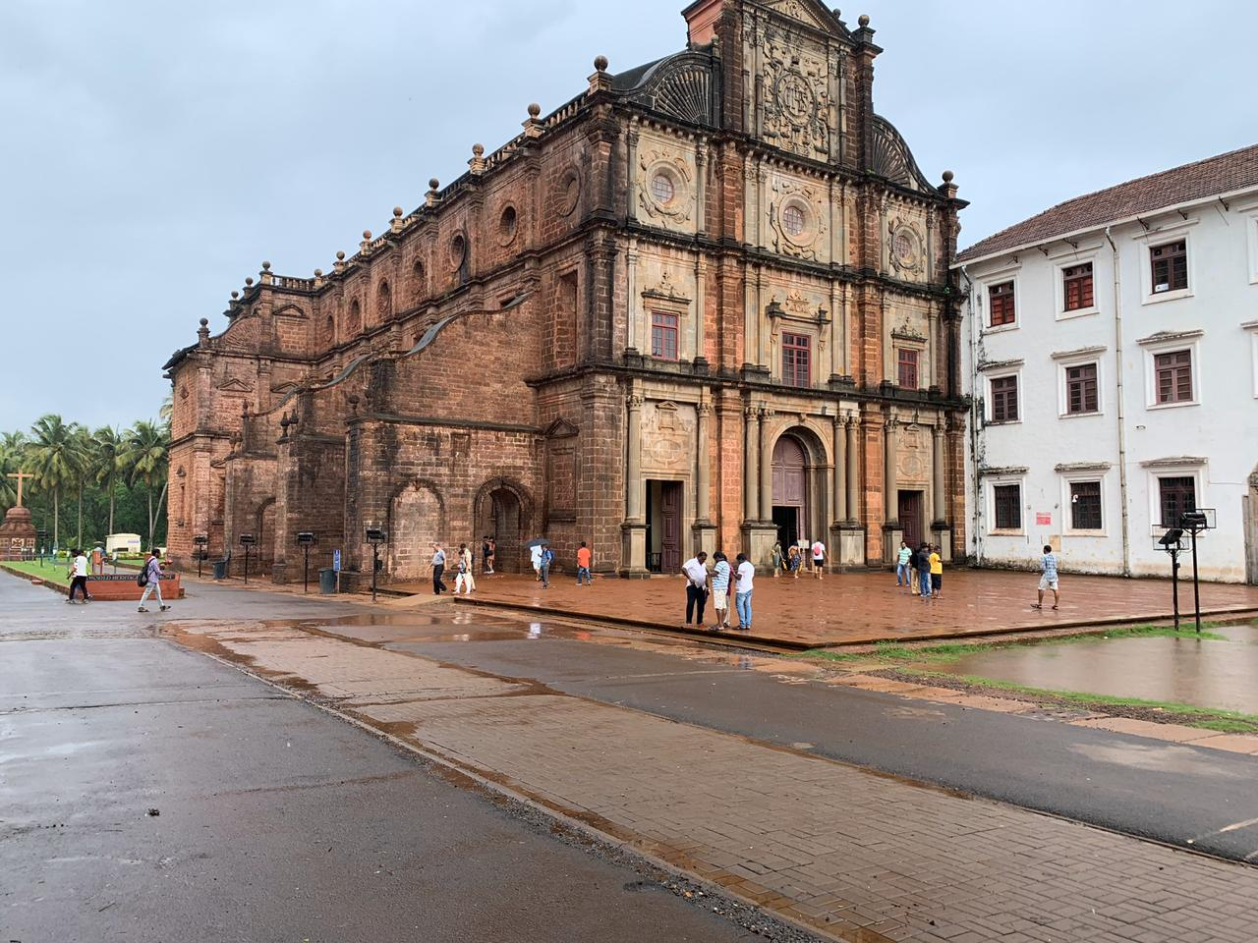
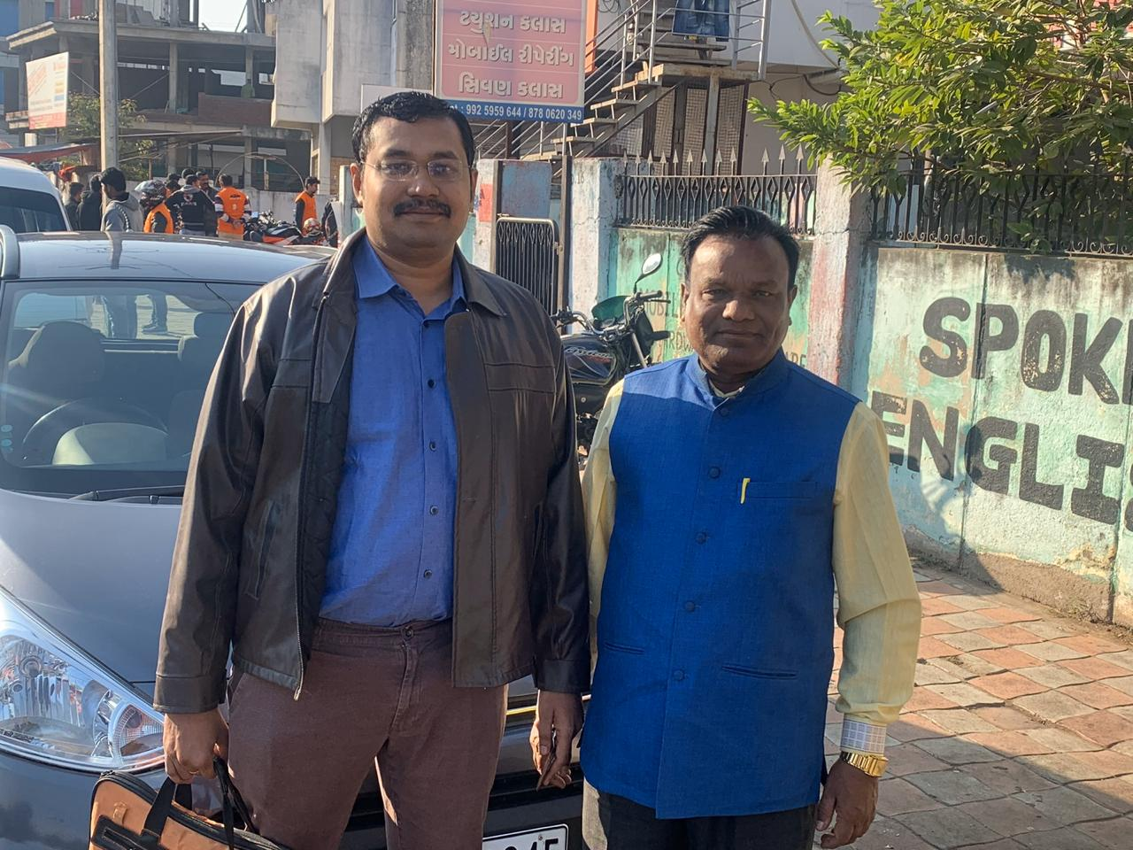
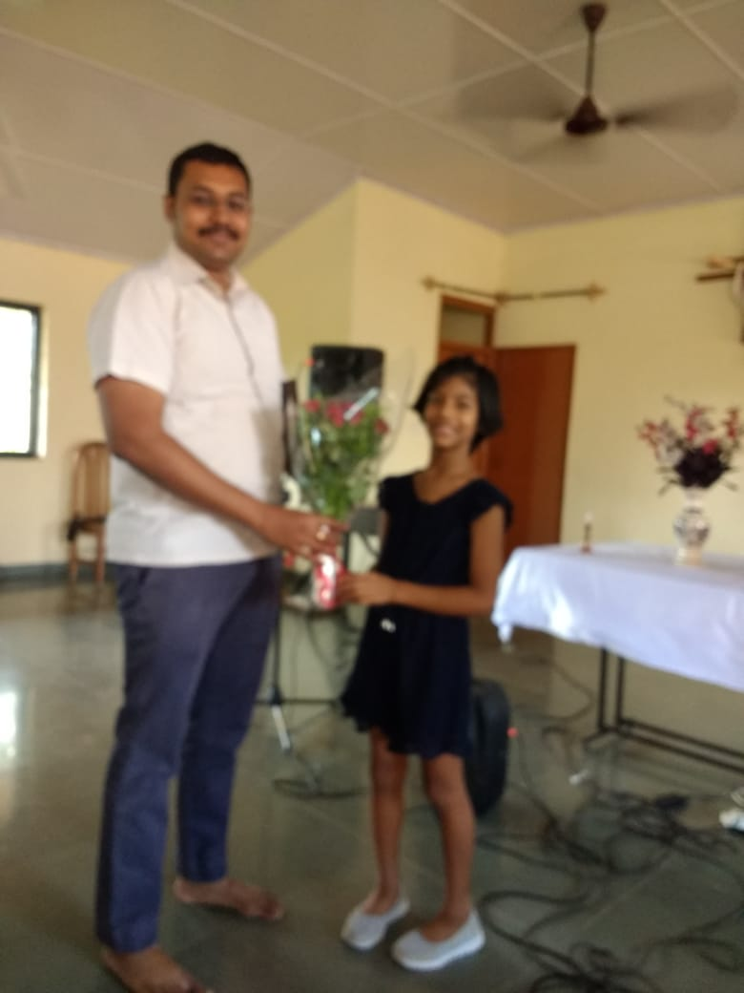
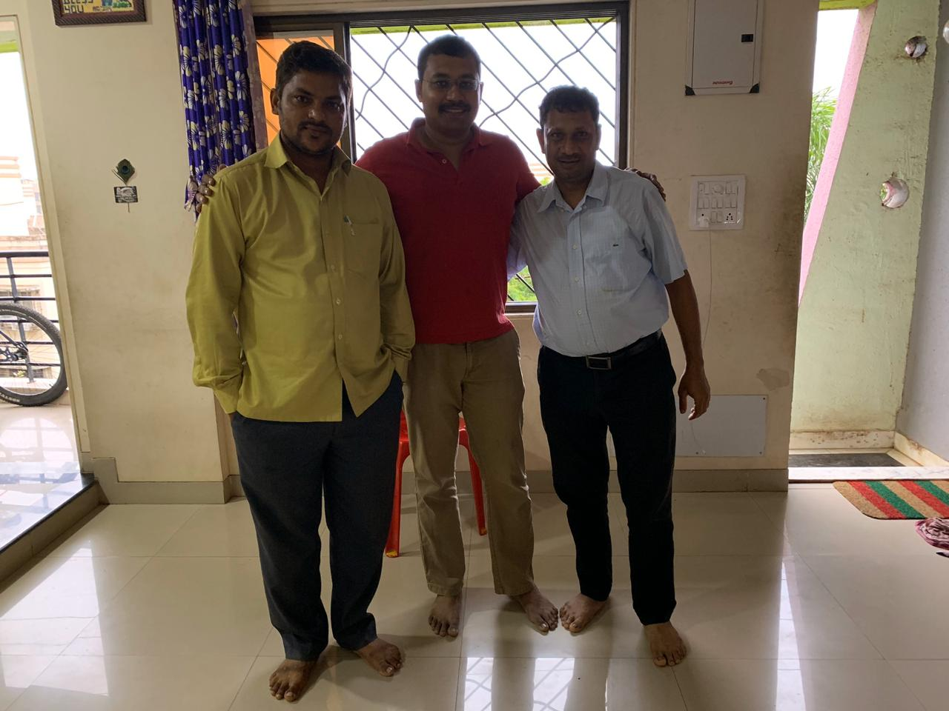
Some Memories – State & District Meet

Slide 18
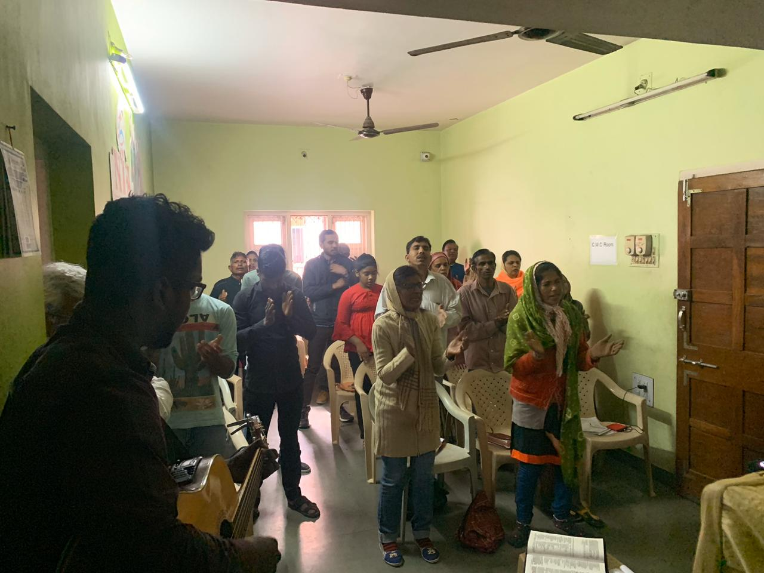
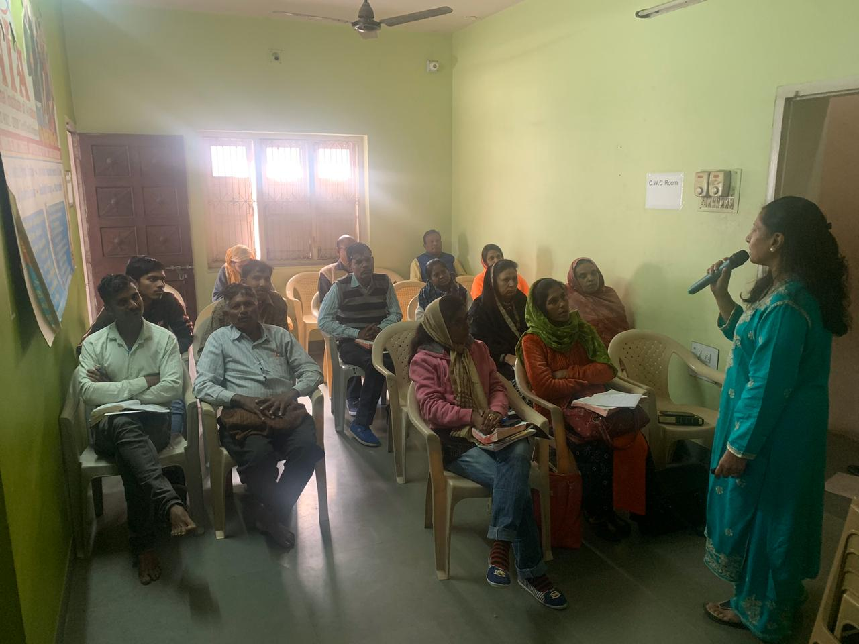
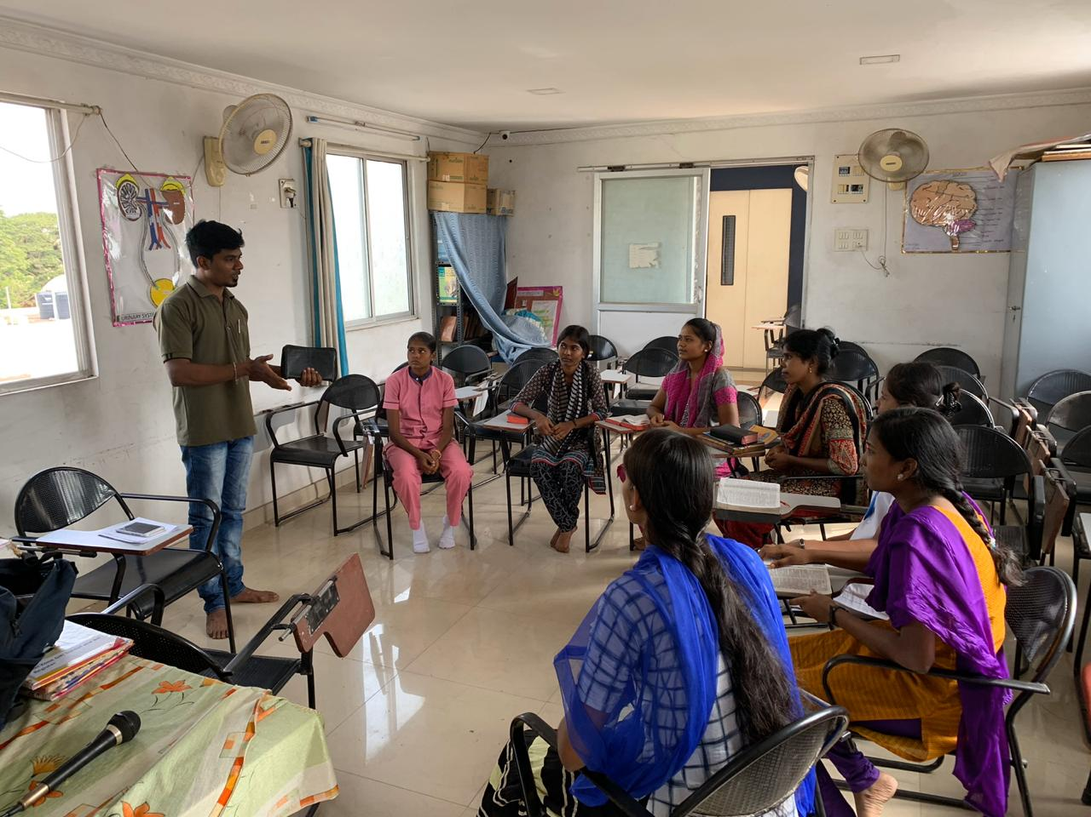
Some Memories – State & District Meet

Slide 19
Joseph School Of Financial Discipline- Panayoor-Chennai- 24,25 Jan 20

Slide 20
Joseph School Of Financial Discipline- Nagercoil-Kanyakumari- 25,26 Jan 20

Slide 21
Joseph School Of Financial Discipline-Basel Mission Compound-Udupi-Karnataka on 29-2-2020

Slide 22
Joseph School Of Financial Discipline- Karamadai-Mettupalayam on14,15-3-2020

Slide 23
Teachers Training Program at Dr Charles Elders Community on 7,8-3-2020

Slide 24
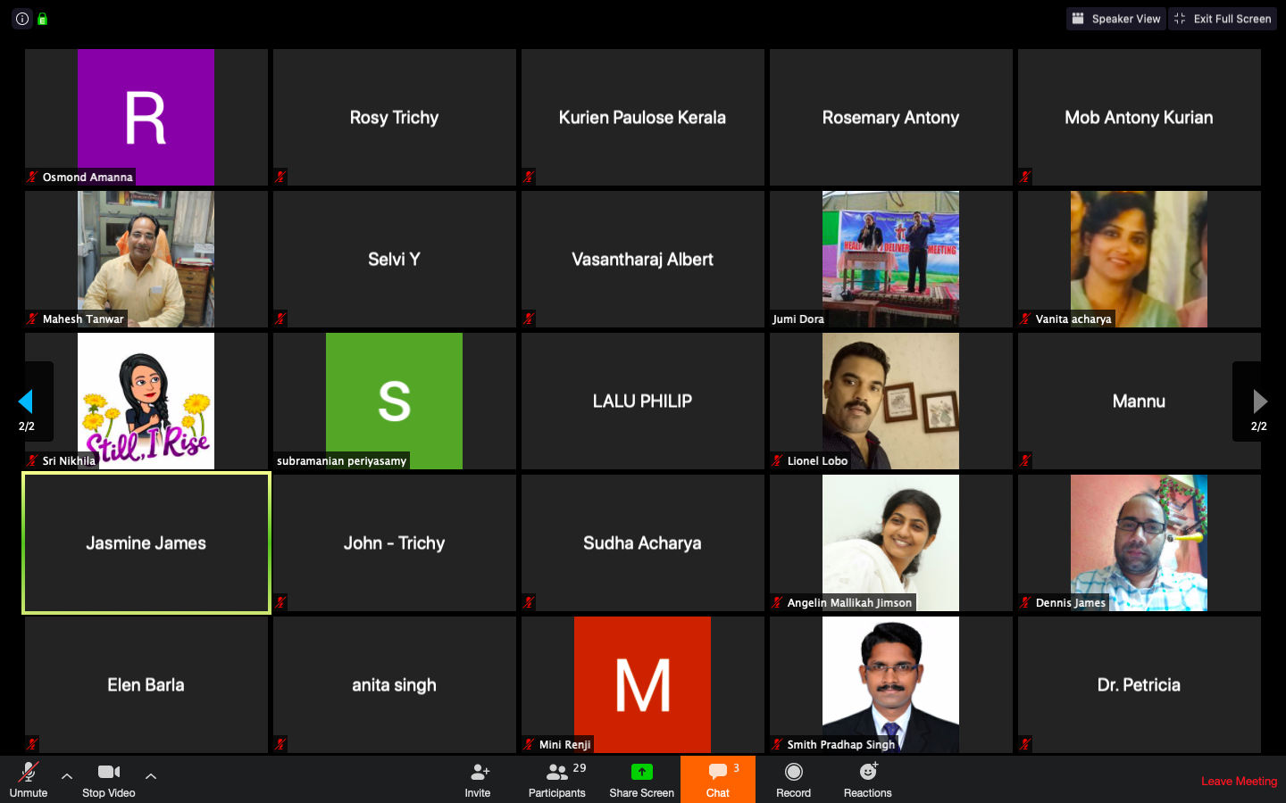
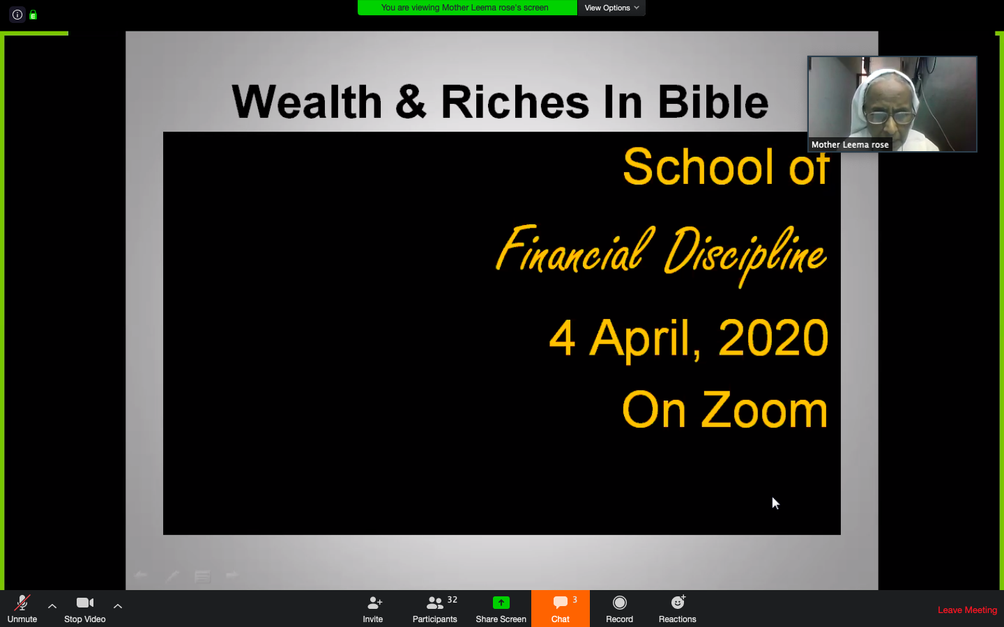
Joseph School Of Financial Discipline- Zoom- 31-3-2020 to 4-4-2020

Slide 25
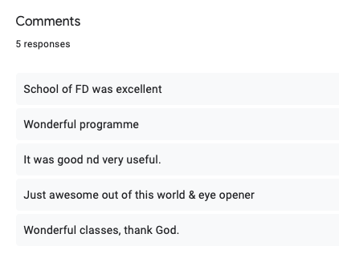
ZOOM

